Slide 1


Tapasya
Hackathon FY23
EDP Team
Data & Analytics Organization
24 Jan 2024
© Hitachi Vantara LLC 2024. All Rights Reserved.

Slide 2




Team - Tapasya
20%
Saritha Ramineni Enterprise Data & Analytics
Mario Morales Enterprise Data & Analytics
Anwar Shaik Enterprise Data & Analytics
Bhagat Katkam Enterprise Data & Analytics

Slide 3
Agenda
1
Problem Statement
2
Proposed Solution
3
Architecture
4
Demo
5
Business Value & Benefits

Slide 4

Problem Statement
Hitachi operates as a data-driven organization.
Our organization holds disparate data fed from different sources, possessing a wealth of valuable information conducive to informed decision-making.
Regrettably, this information is mostly accessible to people with technical expertise.
Consequently, our key leaders and vital business sectors find themselves dependent on dashboards and reports built by the IT Teams, occasionally leading to delays in making timely and accurate decisions.

Slide 5

Proposed Solution
Tapasya is our proposed solution leverages a cutting-edge Natural Language Model algorithm.
It is designed to comprehend questions expressed in simple, natural language and retrieve relevant information from various data sources.
This innovative solution aims to revolutionize the way users interact with our company data, offering a seamless and intuitive question-answering experience.
Whole idea of our model is to emphasize the importance of timely and informed decision-making.

Slide 6
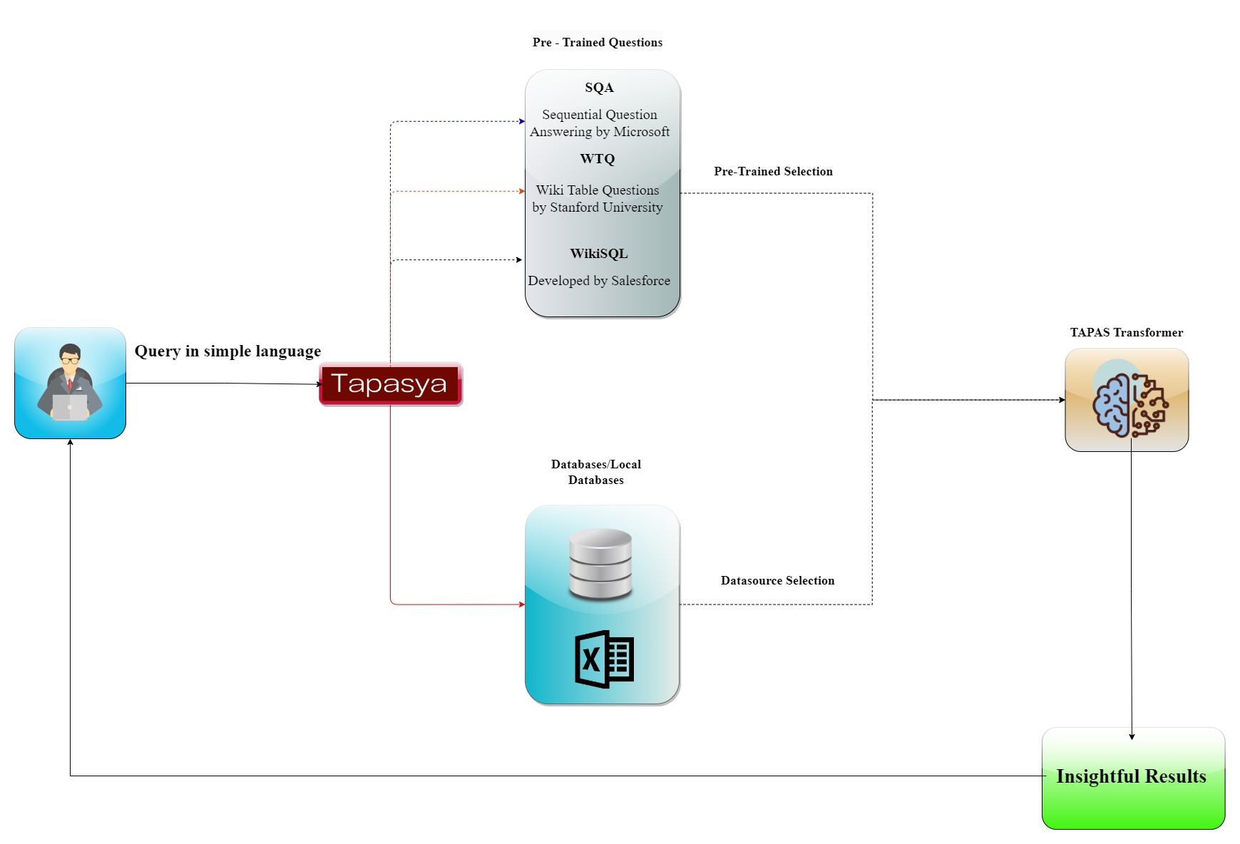
Proposed Architecture

Slide 7
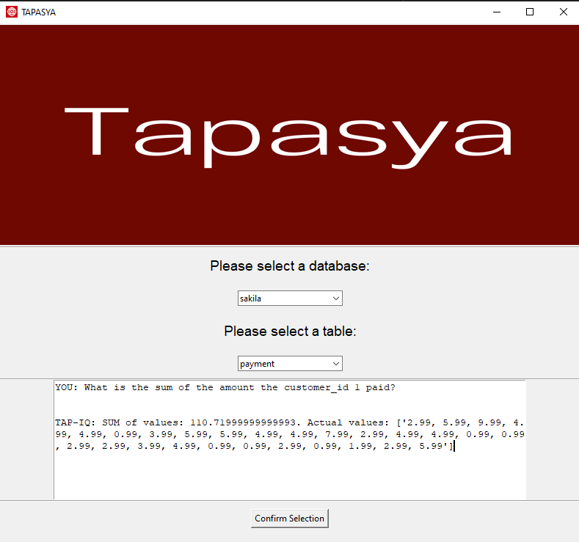
Demo
Here is the Tapasya User Interface
User submits the query in natural language in Tapasya.
Tapasya Model understand the query as it is pretrained questions with different sources like SQA/WTQ/Wiki SQL.
It understand the context of the query and returns the accurate results.

Slide 8
Business Values and Benefits
01
02
03
04
Improved decision making capability
Tapasya can positively impact business strategies, leading to increased revenue.
Tapasya enhance operational efficiency
This can translate into cost savings and increased productivity, ultimately contributing to a positive ROI.
Easy Adaption of Database and tables
It seamlessly handles any relational data sources, allowing you to effortlessly work with personal tables.
Highly Flexible connecting locally/globally
Tapasya being pretrained and operating on local resources, ensures that your data remains within your environment, it fetches the results under 10 seconds.
Key point example: Phosphorescently engage worldwide methodologies.

Slide 9

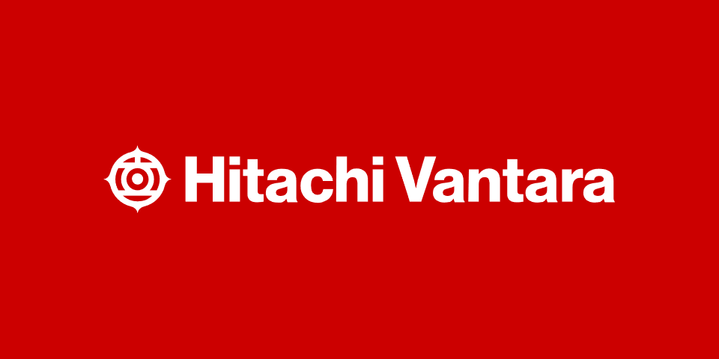
Thank You
9
© Hitachi Vantara LLC 2024. All Rights Reserved.
9

